Slide 1
FIRST-RESPONDER CONNECT
Co-founders:
Anita, Meghana, Monica, Nikitha, Samruda

Slide 2
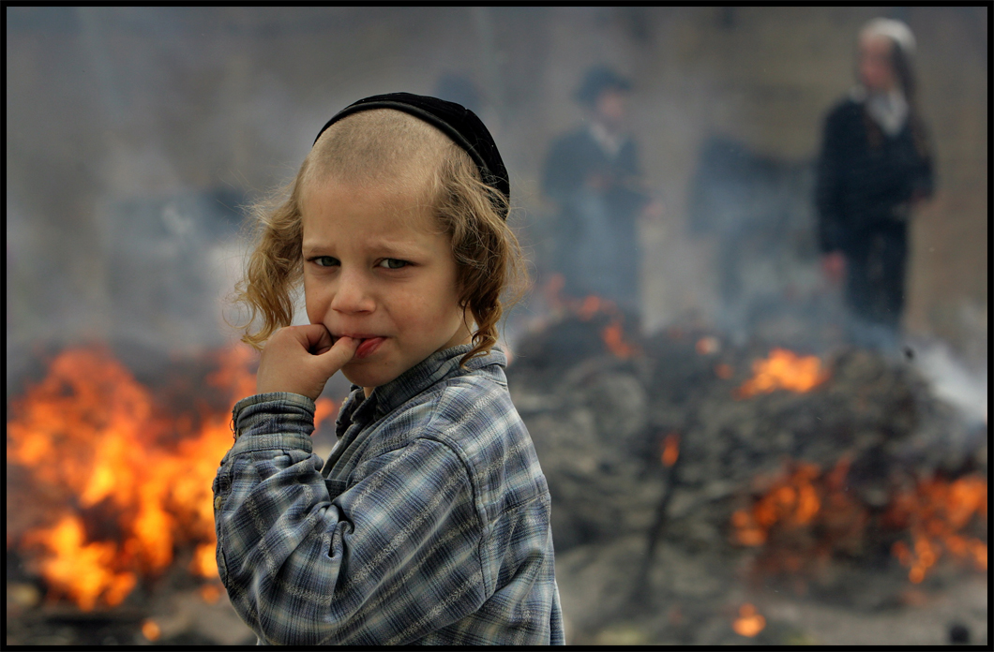
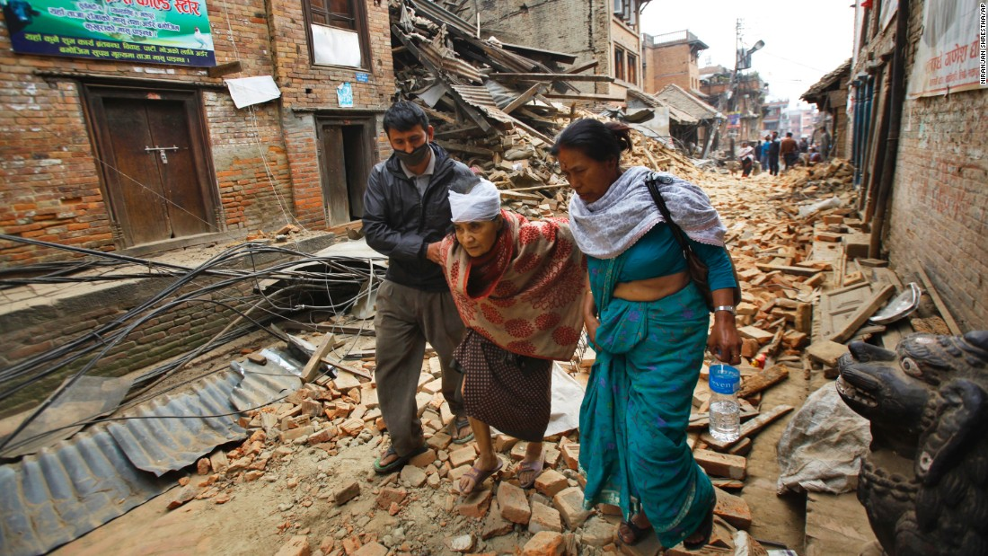
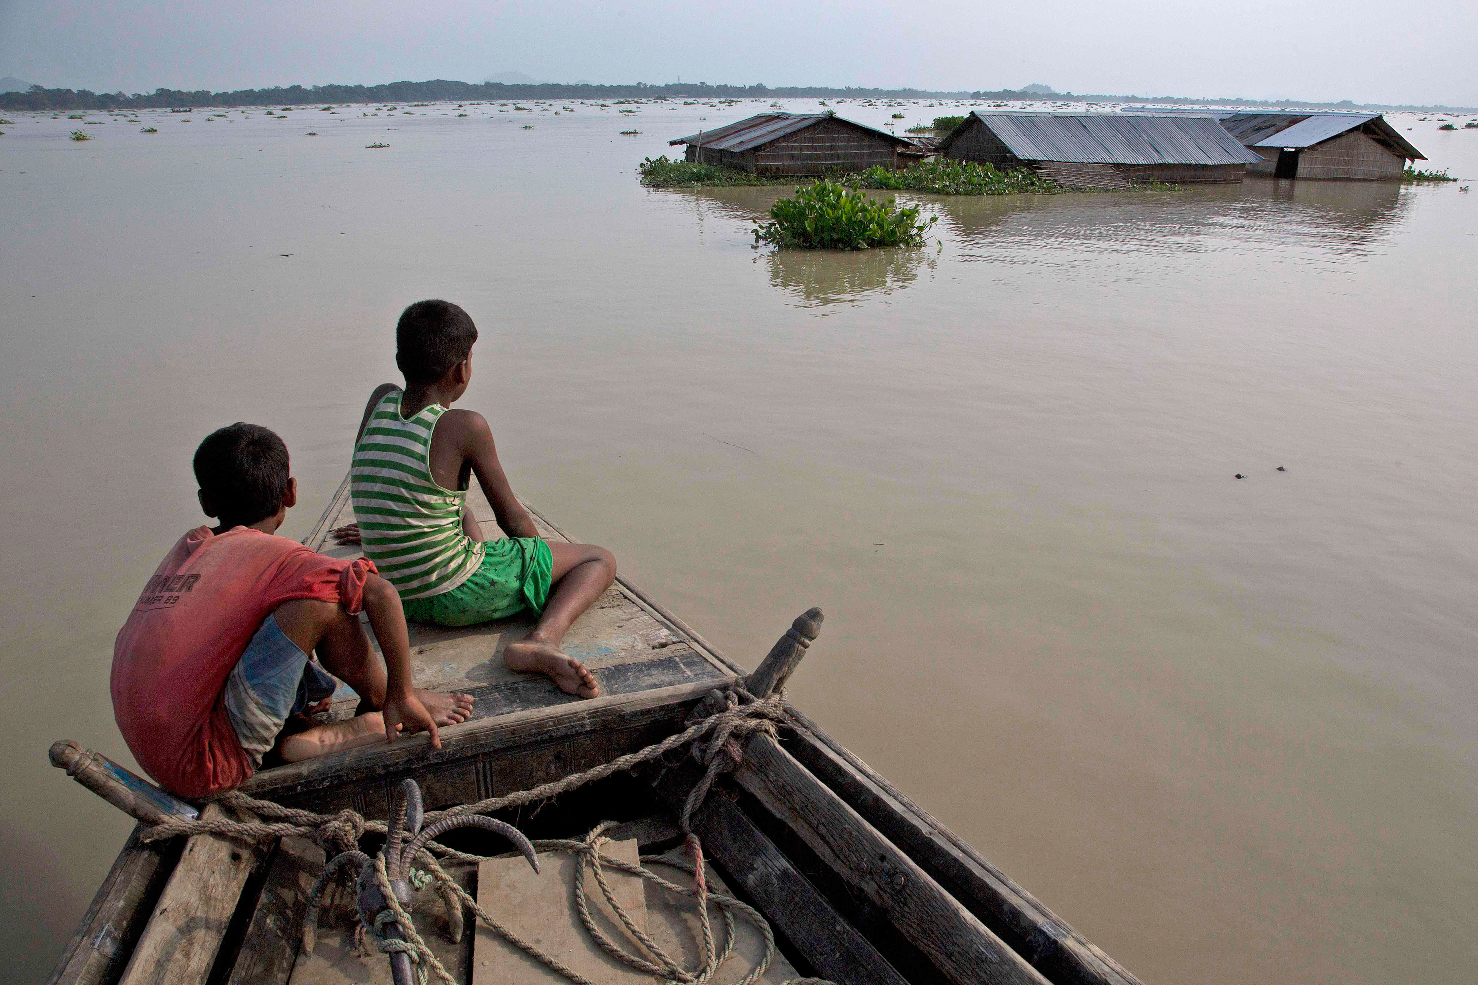
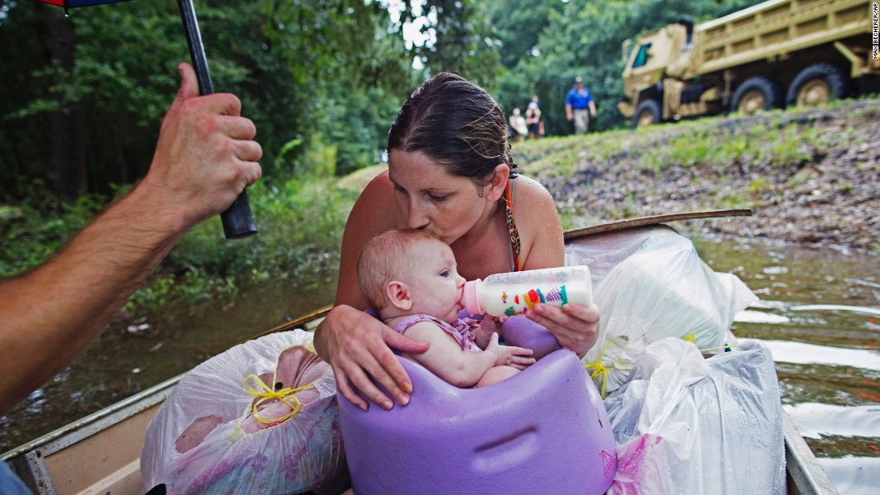
CONTEXT
Every second that goes by after disaster could mean the difference between life and death.
Coordination among First Responder and Organizations is critical for effective disaster management.

Slide 3
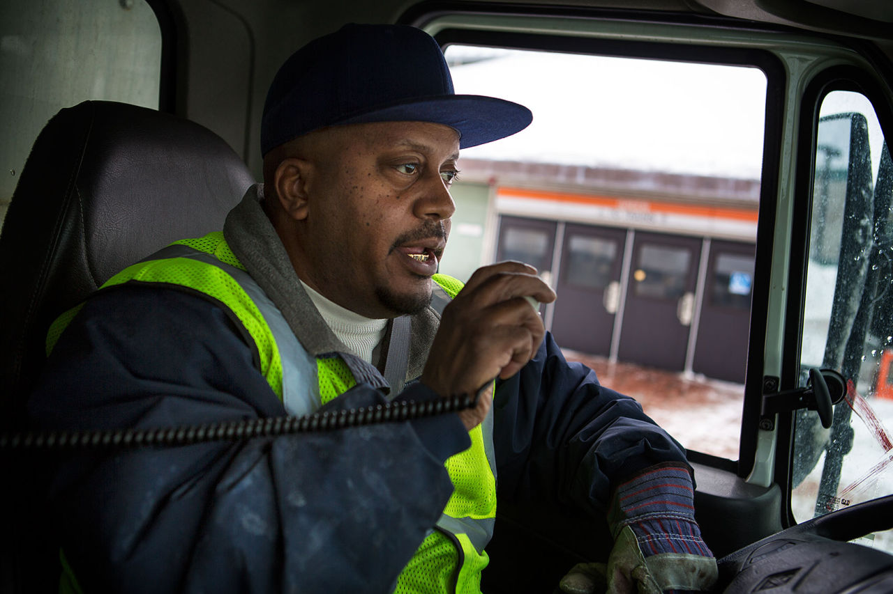
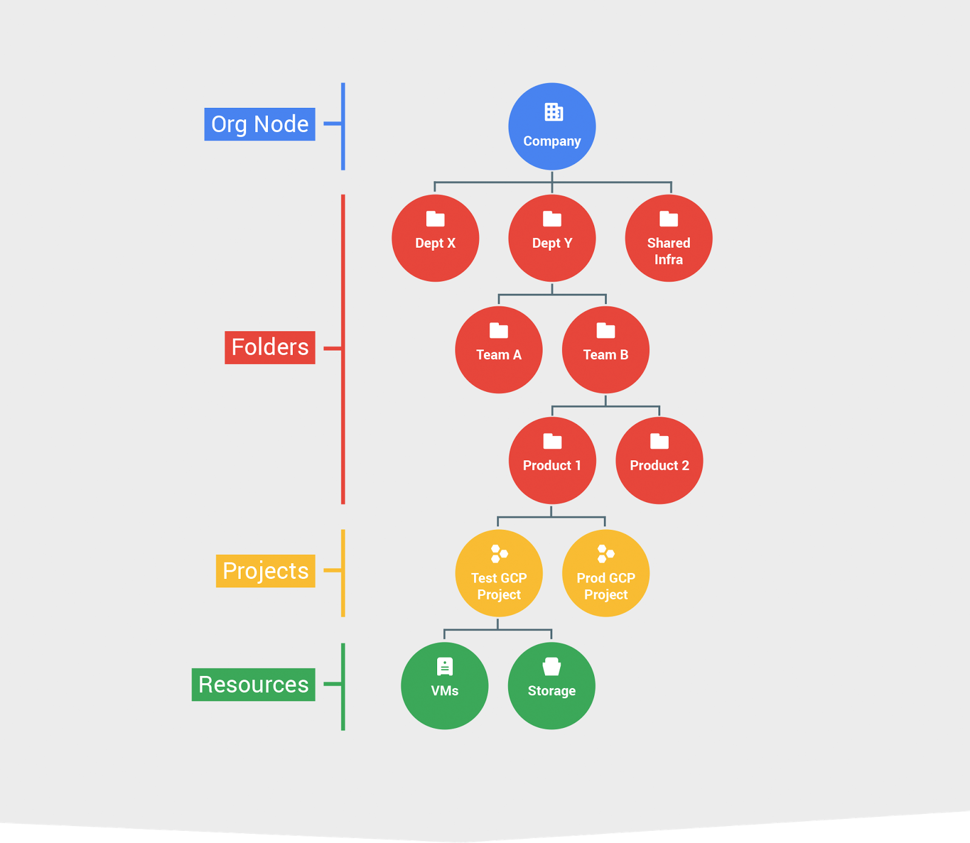
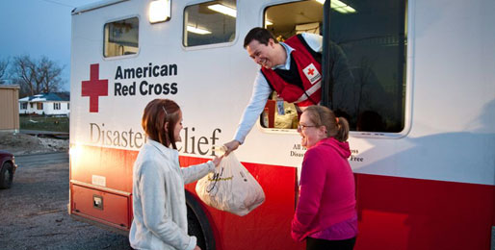
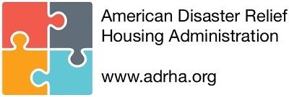
ISSUES ADDRESSED BY PROPOSED MODEL
Communication Problems
Chain of Command
Resource Allocation
Integration between support agencies

Slide 4
COMPLEX SYSTEM OF STAKEHOLDERS
State Govt.
Federal Govt.
EMS
Private Sector
Fire-
fighters
Nonprofit Sector
Local
Govt.
Reserve Military Force

Slide 5
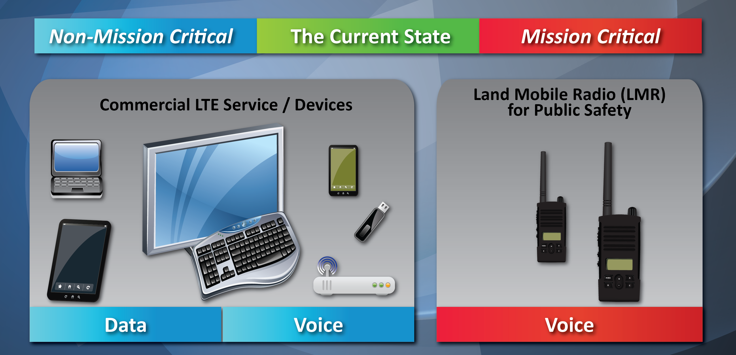
CURRENT STATE OF COMMUNICATION
Notes:
I’m
Suzanne. I own a small doctor’s office, and our phone call numbers are skyrocketing. Not only does this take away the available time of my receptionist, but insurance companies don’t cover the cost of those calls. Worse, it can be impossible for patients to talk to anyone during the especially busy lunchtime call period.
On top of the expense problem, it’s too easy for calls to slip through the cracks. Post-it notes get lost, receptionists are trying to juggle too many tasks, and they can misunderstand or not hear all of what they are told.
Because of all of this, we lose money and patients.

Slide 6
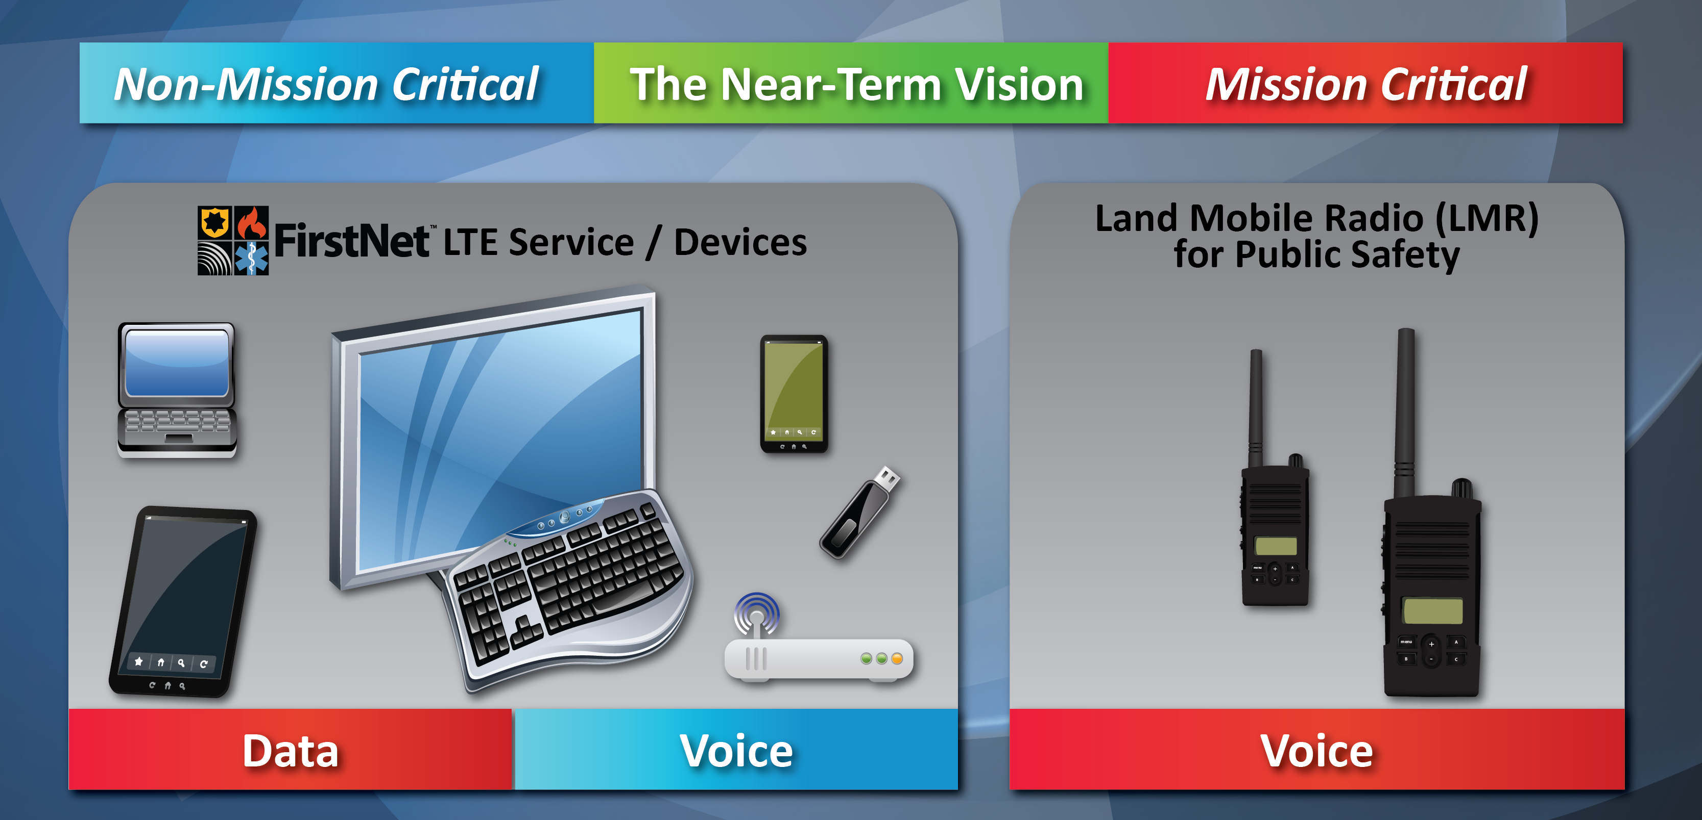
NEAR-TERM VISION OF COMMUNICATION
Notes:
I’m
Suzanne. I own a small doctor’s office, and our phone call numbers are skyrocketing. Not only does this take away the available time of my receptionist, but insurance companies don’t cover the cost of those calls. Worse, it can be impossible for patients to talk to anyone during the especially busy lunchtime call period.
On top of the expense problem, it’s too easy for calls to slip through the cracks. Post-it notes get lost, receptionists are trying to juggle too many tasks, and they can misunderstand or not hear all of what they are told.
Because of all of this, we lose money and patients.

Slide 7
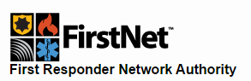

U.S. Department of Commerce in partnership with AT&T
Develop Build Operate Nationwide Broadband Network
Wi-Fi and Mobile Wi-Fi dedicated to First Responders
Intended to stay-up during disaster
To be deployed soon in 2018…
Notes:
I’m
Suzanne. I own a small doctor’s office, and our phone call numbers are skyrocketing. Not only does this take away the available time of my receptionist, but insurance companies don’t cover the cost of those calls. Worse, it can be impossible for patients to talk to anyone during the especially busy lunchtime call period.
On top of the expense problem, it’s too easy for calls to slip through the cracks. Post-it notes get lost, receptionists are trying to juggle too many tasks, and they can misunderstand or not hear all of what they are told.
Because of all of this, we lose money and patients.

Slide 8

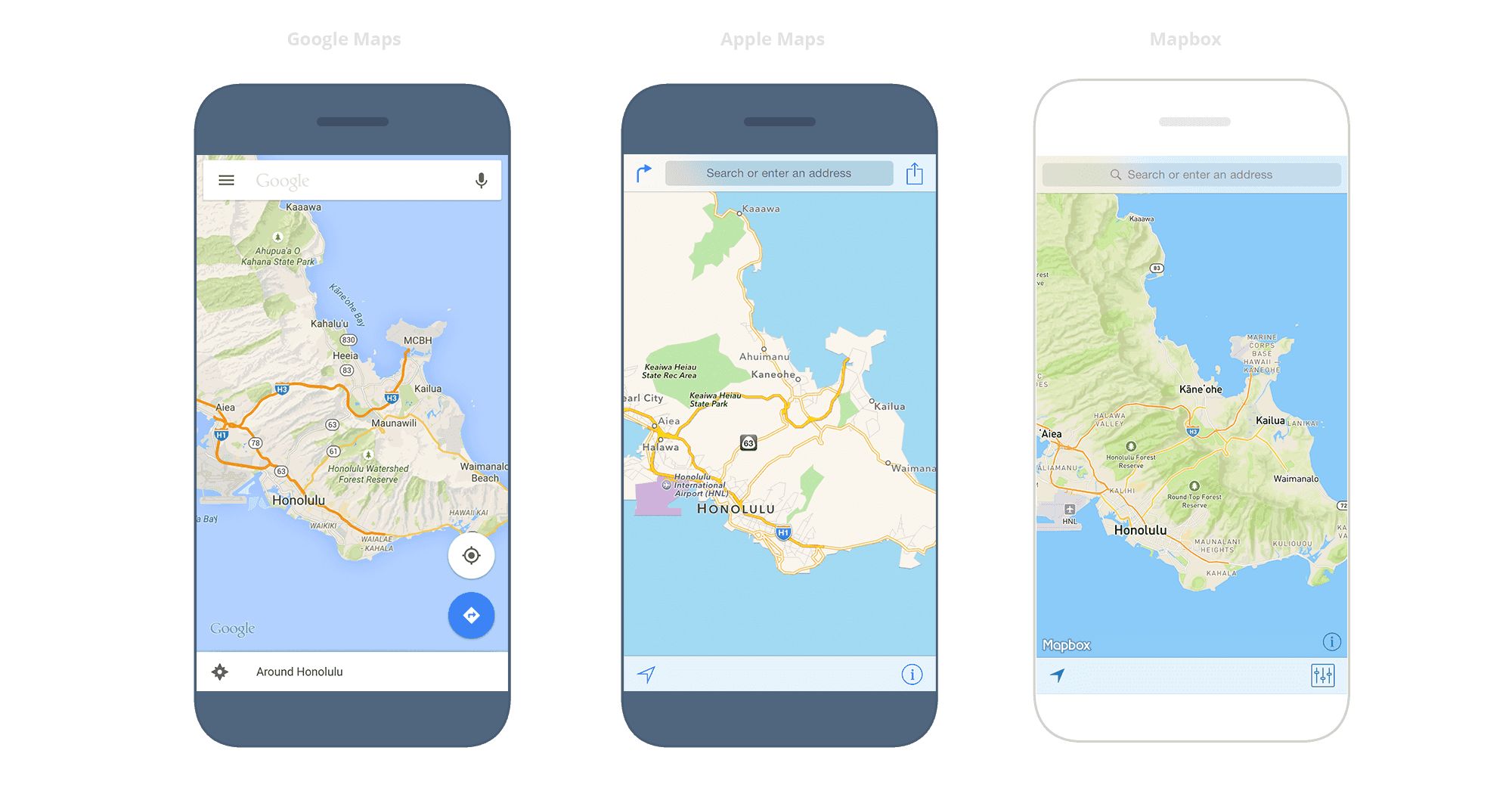

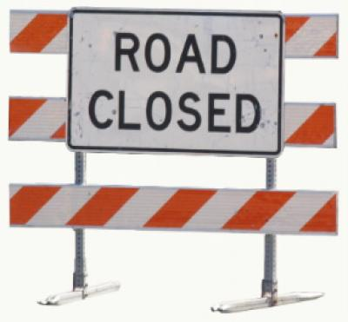


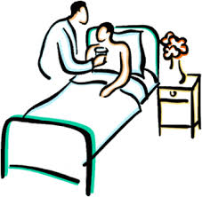
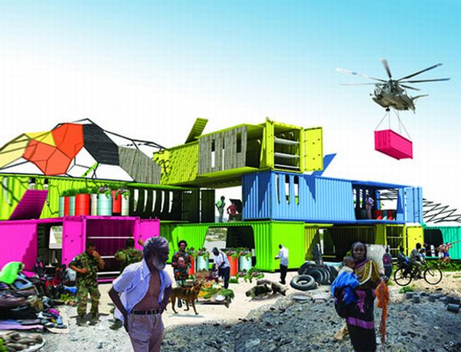
Proposed Model: Integrated Emergency Response Framework

Slide 9
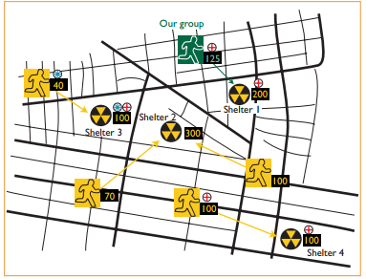
Allocation Scenario

Slide 10
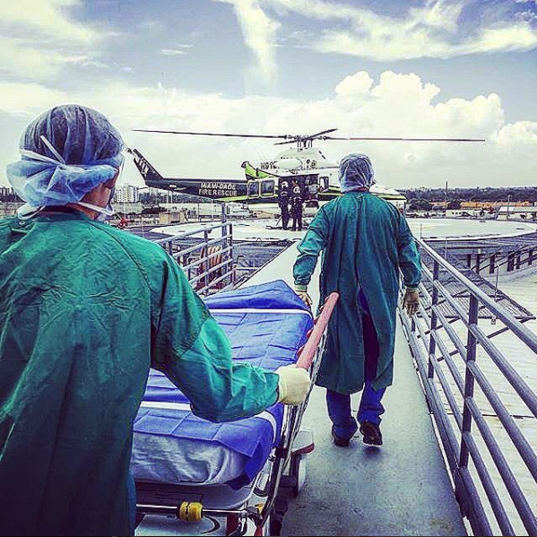
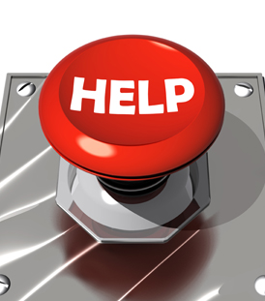
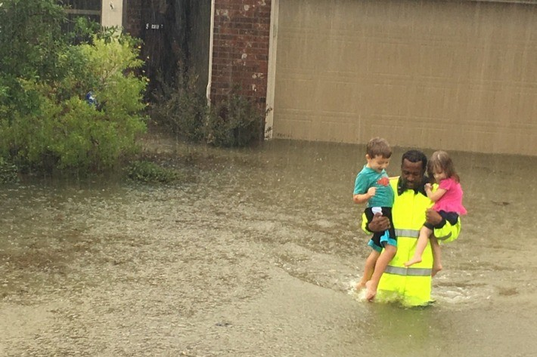
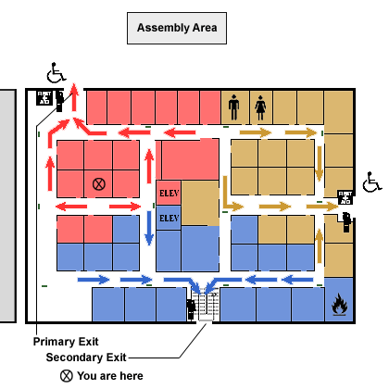
POTENTIAL ADD-ONS
Locating/counting chronic patients around affected location
Panic Alarms
Locating Children
Area / Block evacuation Plan

Slide 11
Proposed Model: Integrated Emergency Response Framework
Response Effectiveness
Standard
Control
Communication
Adaptation
Planning
Real Time Response
Synchronized Information
Actor Actions
Resources
Integration
Learning
Reliability

Slide 12
TECHNOLOGIES USED
1. PWA Progressive Web App to build Mobile Application
2. Java Servlet in the Backend
3. Dataset used CMS 2008-2010 Data Entrepreneurs’ Synthetic Public Use File (DE-SynPUF)
4. R Programming on Dataset

